Slide 1
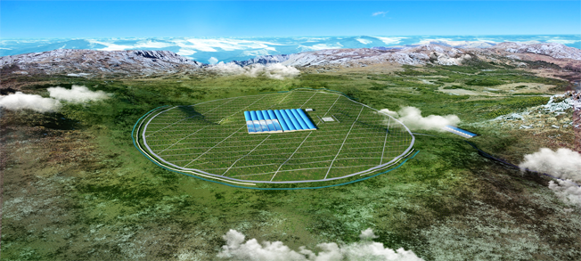
Expectation of Cosmic Ray Energy Spectrum with LHAASO
L. L. Ma, S.S.Zhang, B.Y. Bi, L.Q.Yin, Z.Z. Zong for LHAASO collaboration
IHEP,CAS
Beijing China

Slide 2
Outline
Difficulties in cosmic ray detection
LHAASO introduction
LHAASO science in cosmic ray measurement
Performance study of LHAASO detectors
Summary

Slide 3
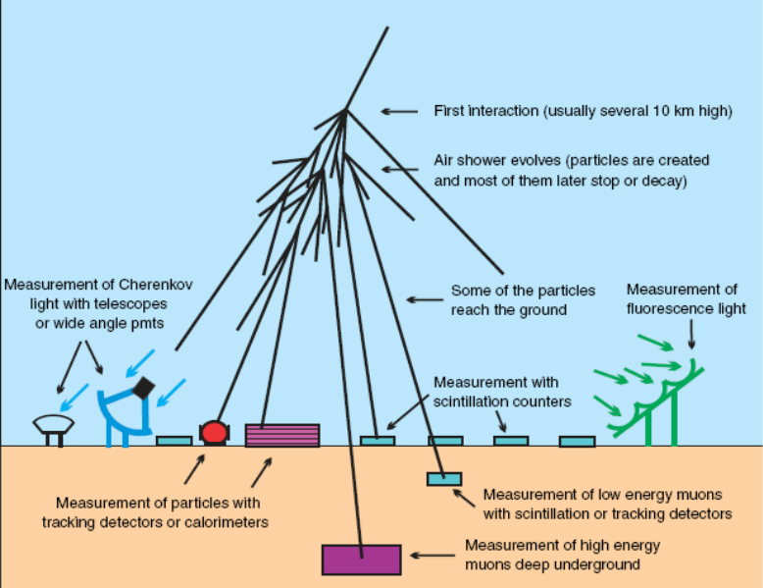
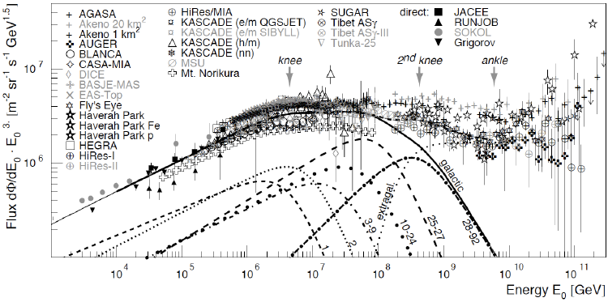
Difficulties in cosmic ray detection
Energy > 100 TeV Air shower measurement
  EAS array
  Cherenkov telescope or Array
  Fluorescence telescope
Calibration of primary energy estimate uncertain.
Composition measurement difficult
Model dependent

Slide 4
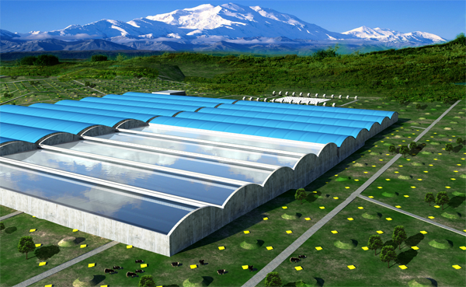
LHASSO Introduction
4400m above sea level
Wide Field of View Cherenkov telescope Array (WFCTA)
18 Telescopes
Water Cherenkov detector Array
(WCDA) 78,000m²
Geometry reconstruction
Core information
Energy meaurements
Hillas
Geometry reconstruction ，
Muon content
1KM² Array (KM2A)
5195 scintillator detectors every 15 m
1171 muon detectors every 30m

Slide 5
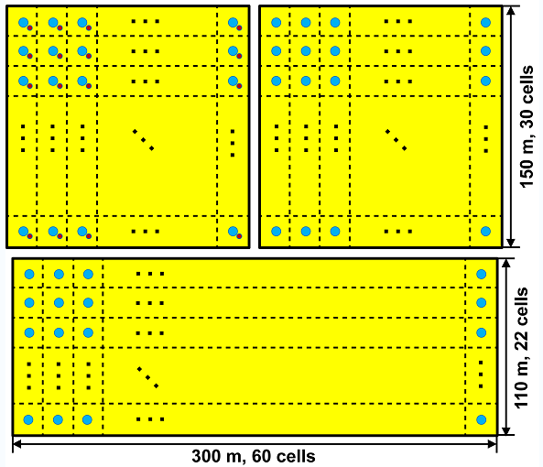
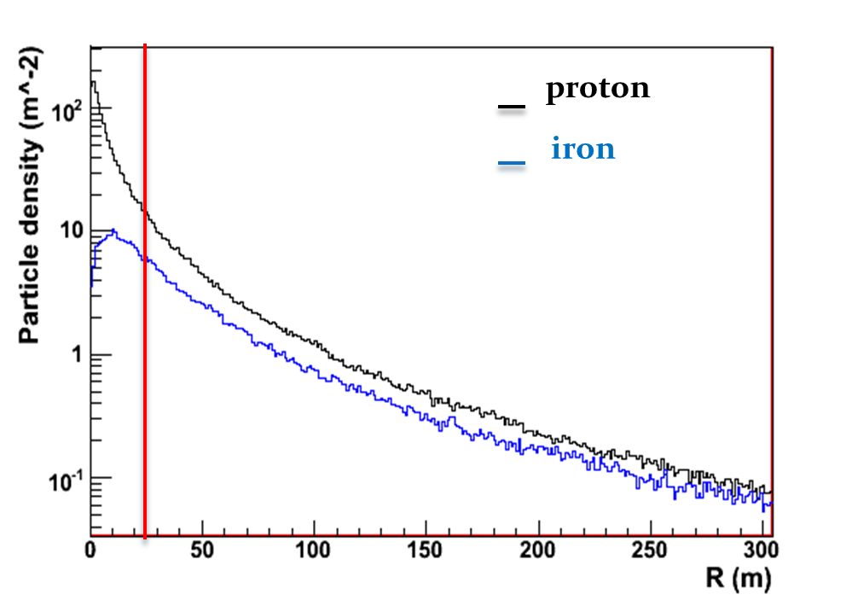
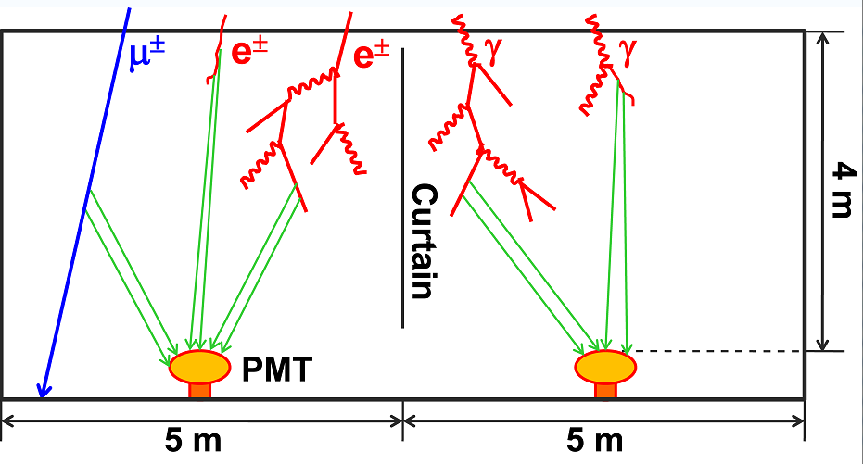
Water Cherenkov Detector Array(WCDA)
Total cell: 3600
Total area: 90000m²
Time resolution: <2ns
Two types PMTs: 8 inches and 1 inch
Increase the dynamic range
Get the core information

Slide 6
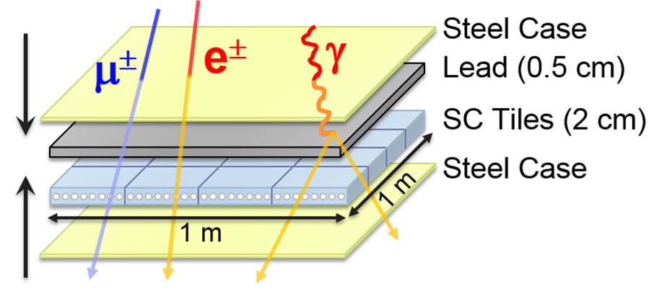
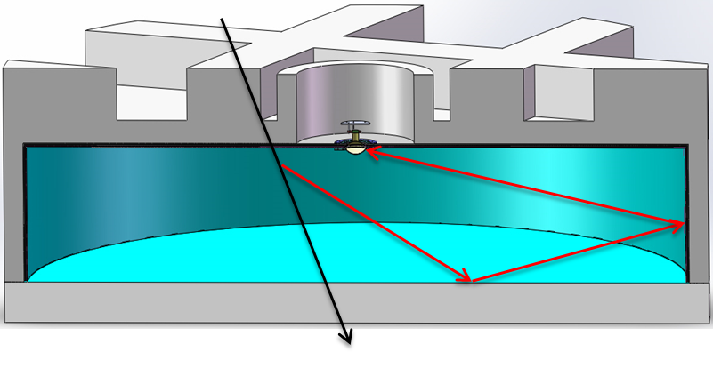
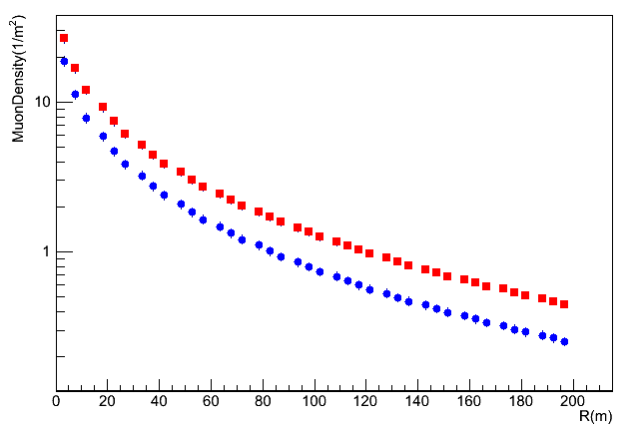
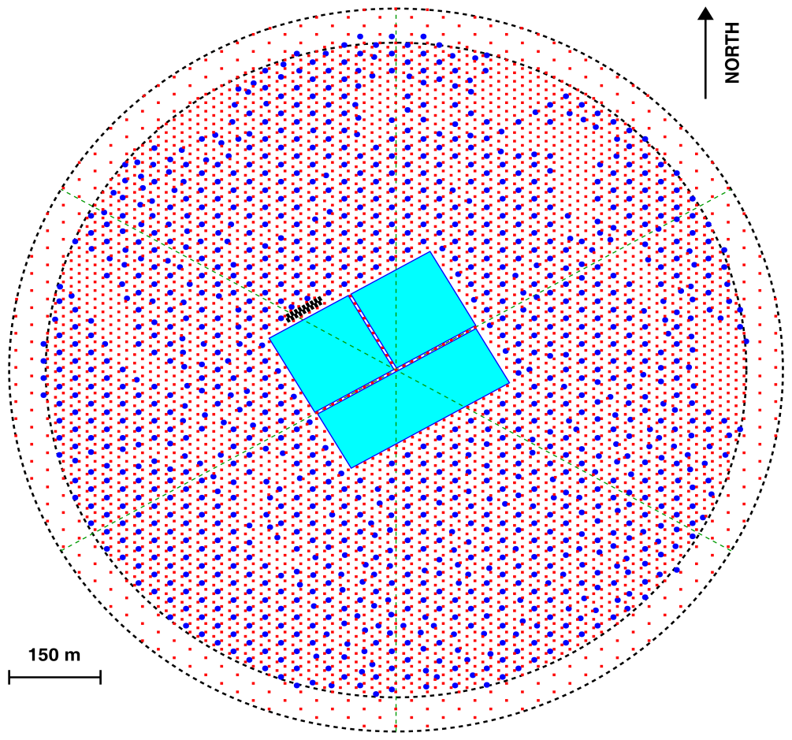
KM² Array (KM2A)
2.8m
1.2m
 | ED | MD
Effective area | 1m² | 36m²
Spacing | 15m | 30m
NO. of detectors | 5195 | 1171
Time resolution | 2ns | 10ns
Red:iron
Blue:proton
10PeVEnergy<100PeV
Muon number
Core reconstruction : 5m
Direction reconstruction: 0.3°

Slide 7
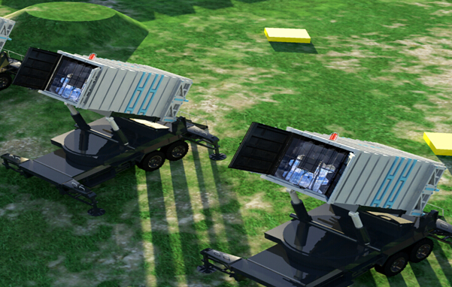
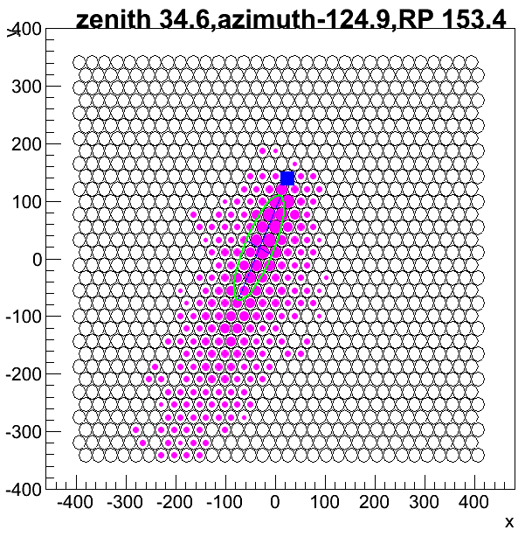
Wide Field Cherenkov
Telescope Array
(WFCTA)
Reflectors:
  25 spherical mirrors
  Side length：300mm
  curvature：5800mm
Cameras
  32 x 32 SiPMs
  Wenston Cone
  Pixel diameter:25.4mm
  Focal length: 2870mm
Hillas Parameters
Xmax
Energy reconstruction

Slide 8
LHAASO science in cosmic ray measurement
Measure individual cosmic ray spectra from 10TeV to EeV
  Multi-parameters, Multi-stages
  10TeV-100TeV
  Energy Scale
  WCDA, WFCTA
100TeV-10PeV
  Knees for H,He,…
  WCDA, WFCTA, KM2A
10PeV-100PeV
  knee of Fe
  WFCTA, KM2A
100PeV-2EeV
  2nd knee & composition changing
  Transition from galactic to extra-galactic
  WFCTA, KM2A

Slide 9
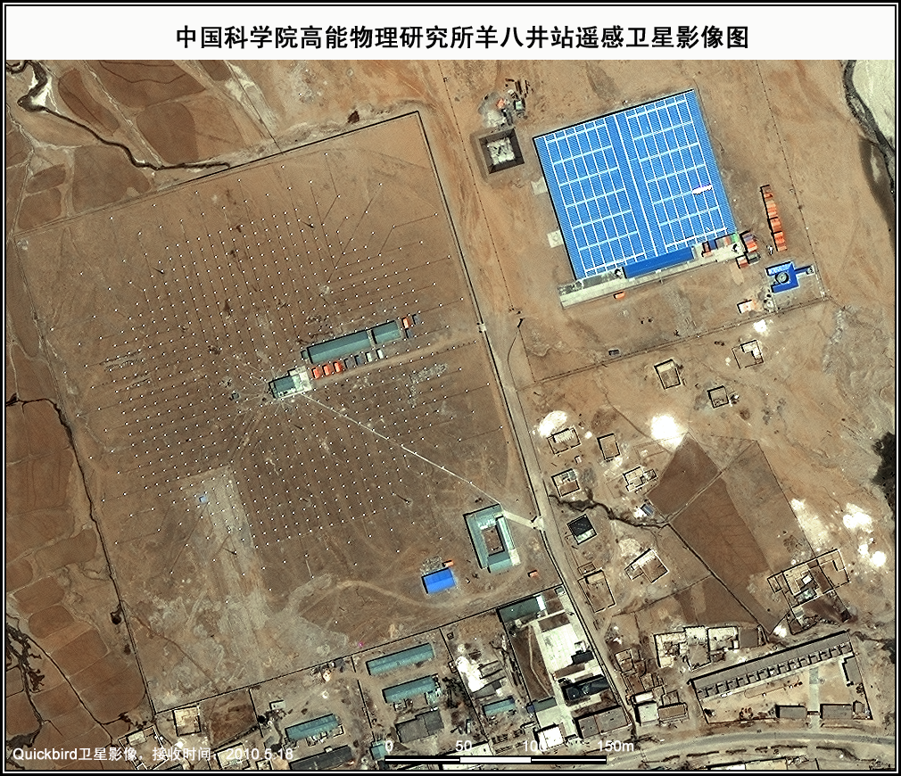
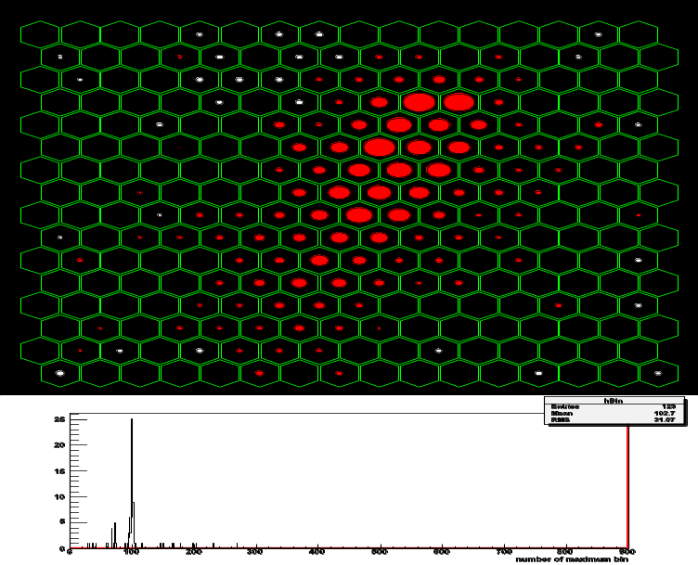
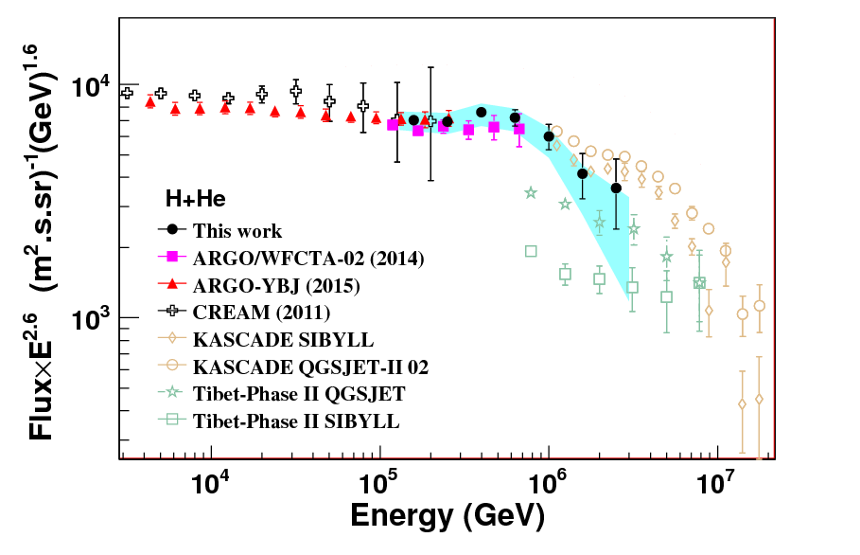
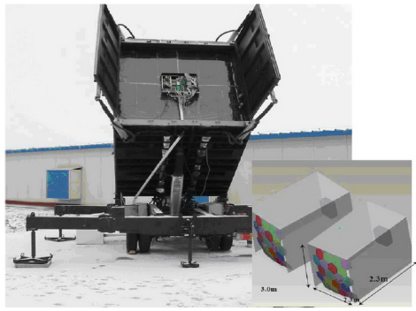
Energy scale of WFCTA prototype
Wide Field of View Cherenkov Telescope (WFCTA/LHAASO)
5m² spherical mirror；
16×16 PMT array
Pixel size 1°；
FOV: 14°× 16°;
Elevation angle: 60°.
One of Cherenkov event
80m
    The knee of (700±230_{stat.}±70_{sys.}) TeV is found
CREAM:
1.09x1.95x10⁻¹¹(E/400TeV)^{-2.62}
ARGO-YBJ:
1.95x10⁻¹¹(E/400TeV)^{-2.61}
LHAASO Prototype:
0.94x1.95x10⁻¹¹(E/400TeV)^{-2.62}

Slide 10
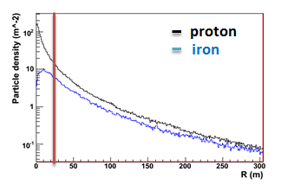
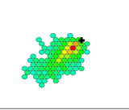
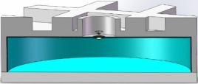
Performance of LHAASO detectors from 100TeV to 10PeV
WCDA
  Core reconstruction: 3m
  Arrival direction reconstruction: 0.3°
  No. of particles near the core
WFCTA
  SIZE (total PE in image)
  Width, Length
  Distance between arrival directions to the image center
KM2A
  Total Muon number

Slide 11
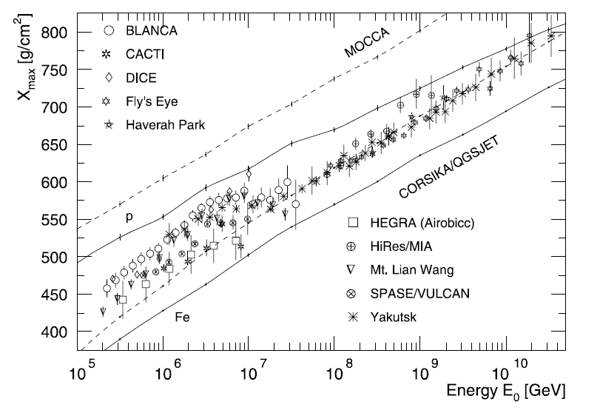
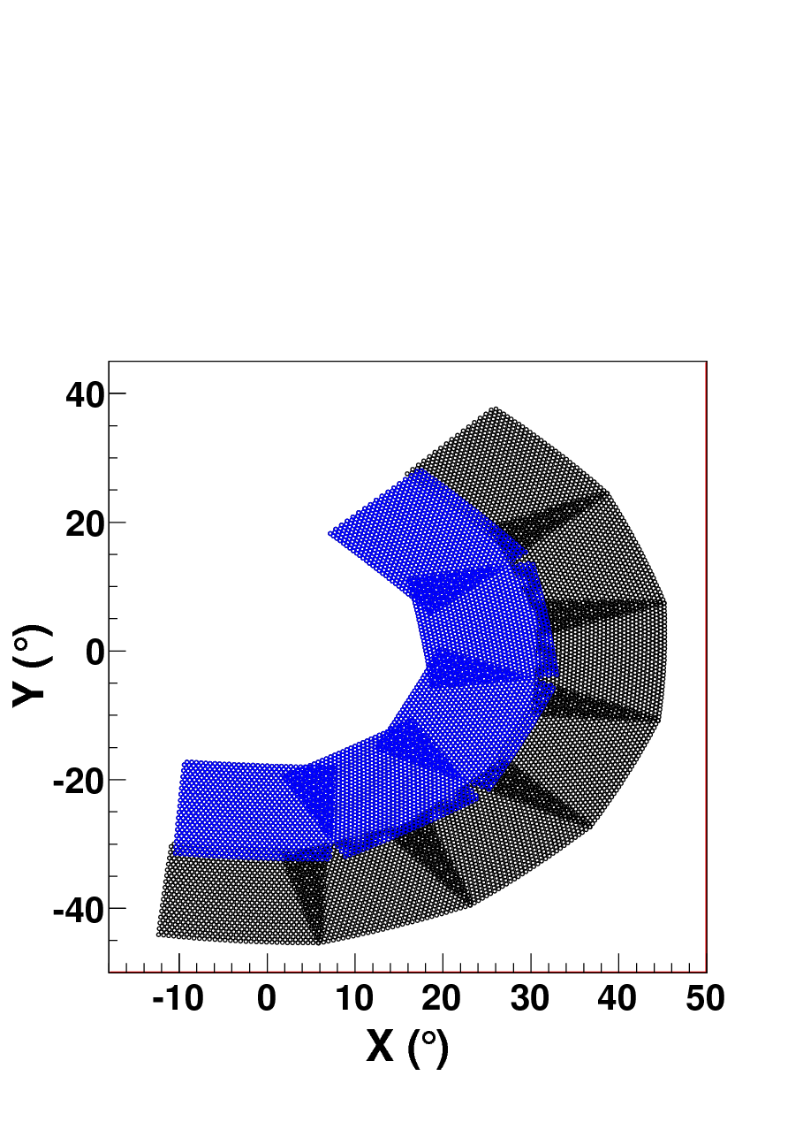
Shower generation
  CORSIKA 6990
  Energy range: 100TeV ~10PeV
  Compositions:
    Proton, helium, CNO, MgAlSi, iron
  hadronic model: QGSJETII02+ GHEISHA
Pointing direction of WFCTA
  28°，35°in zenith
  Xdepth: 700g/cm²

Slide 12
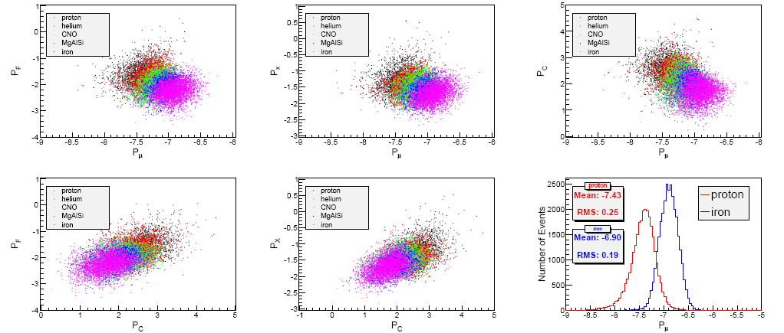
Correlations of parameters

Slide 13
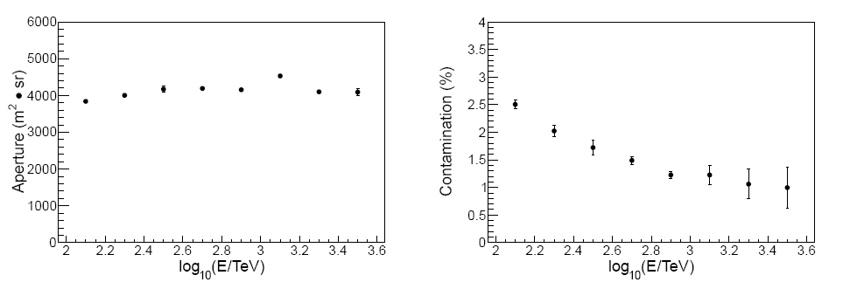
Aperture and contaminations
Proton + helium
 | Proton | Proton+helium
Aperture m²Sr | 1500 | 4000
Purity | 90% | 95%

Slide 14
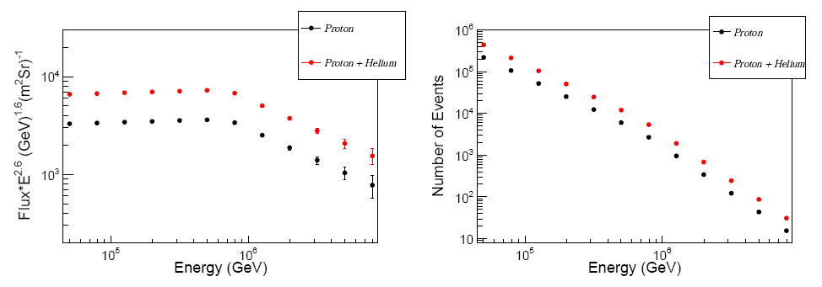
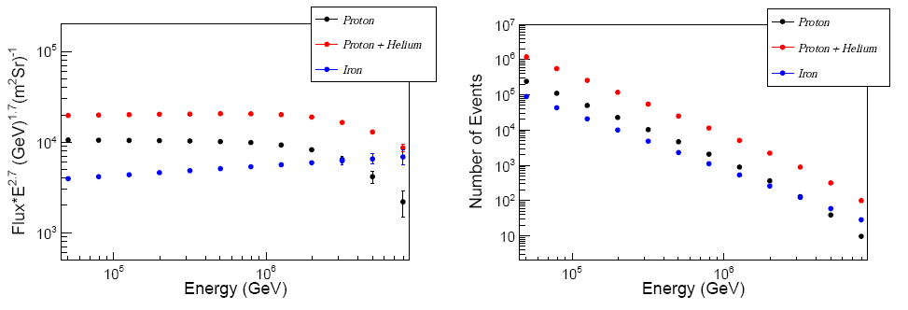
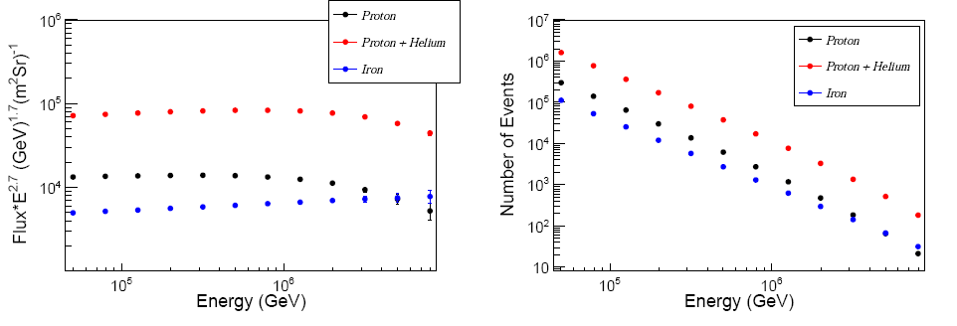
Event rates and expected spectra based on 15% duty circle
ARGO-WFCTA model
Horandel model
H4A model

Slide 15
Performance of LHAASO detectors from 10PeV to 100PeV
Carried out by KM2A, WFCTA
KM2A:
  Geometry reconstruction
  No. of Muons
  No. of electromagnetic particles
WFCTA:
  Px: angular distance between shower arrival direction and the image center
  Npe: Number of pe. in the Cherenkov image
600m,766.2m

Slide 16
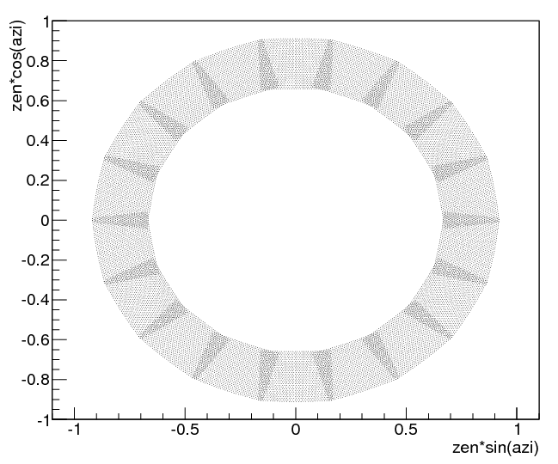
Air depth with zenith 45°
Shower generation
  CORSIKA V74005
  Energy range: 10PeV ~100PeV
  Compositions:
  Proton, helium, CNO, MgAlSi, iron
  hadronic model: QGSJETII04+FLUKA
Pointing direction of WFCTA
  45°in zenith
  0~360°in azimuth
Air depth of LHAASO

Slide 17
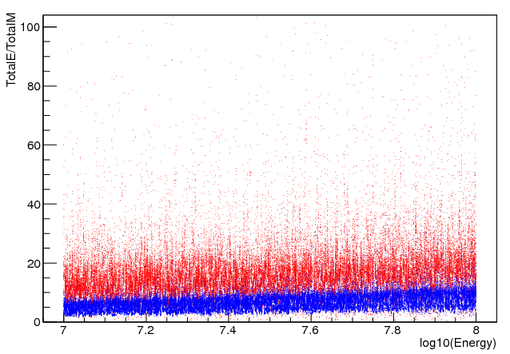
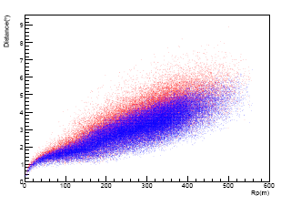
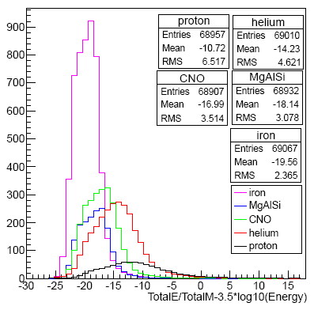
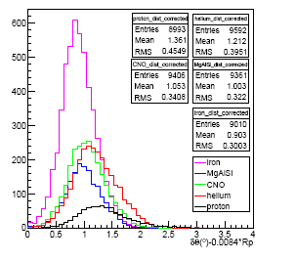
Composition separation
Obtained from KM2A
Log10(Ne/Nmuon)
Blue: iron
Red:proton
Obtained from WFCTA
Distance: the angular distance between image center to the arriving directions

Slide 18
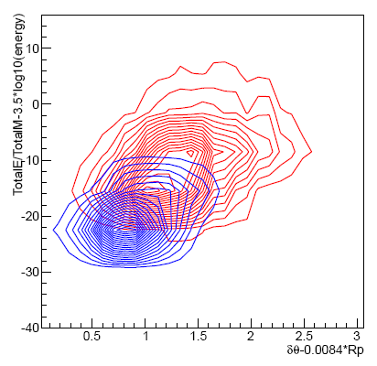
KM2A
WFCTA
Purity in selecting iron: 84%
Purity in selecting iron and MgAlSi: 94%

Slide 19
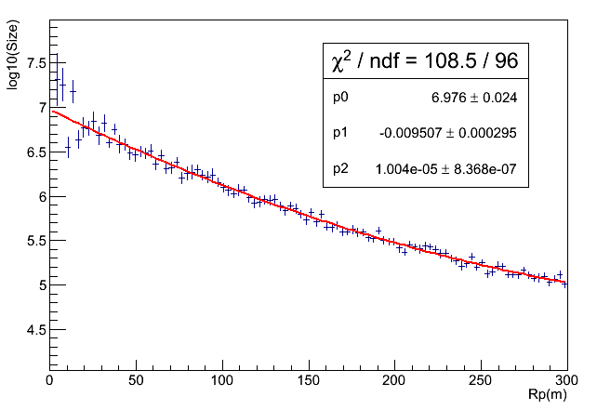
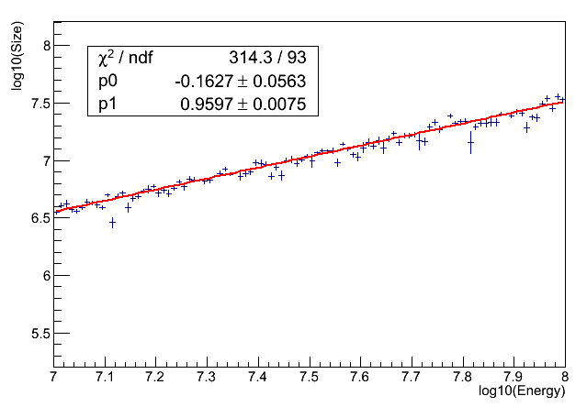
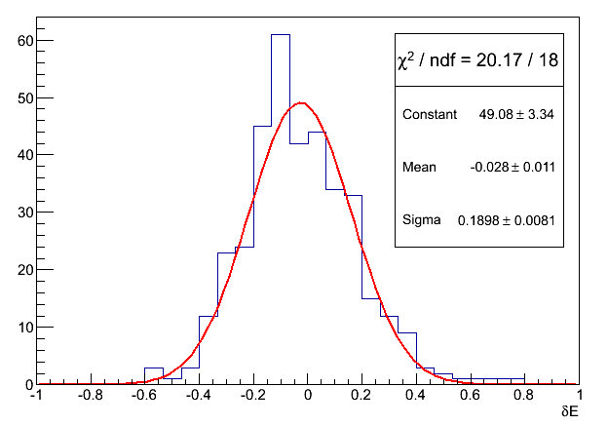
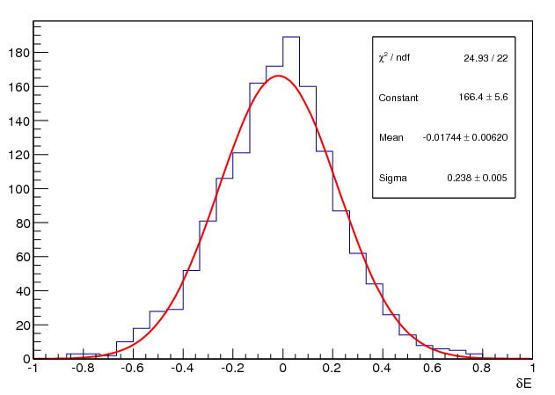
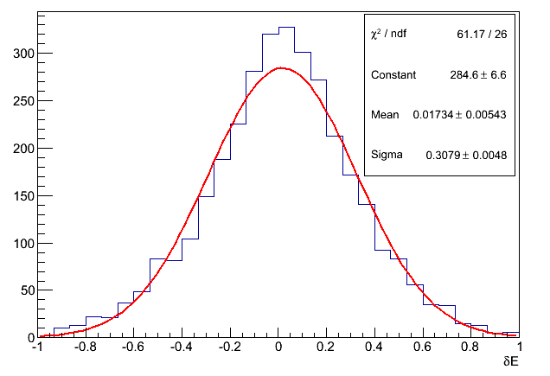
Energy reconstruction
The reconstructed energy is a function total Npe recorded by WFCTA and Rp
Energy resolution
  <20% (Rp<100m)
  <25%(Rp<200m)
  ~30%(Rp<300m)
Rp<100m
Rp<200m
Rp<300m

Slide 20
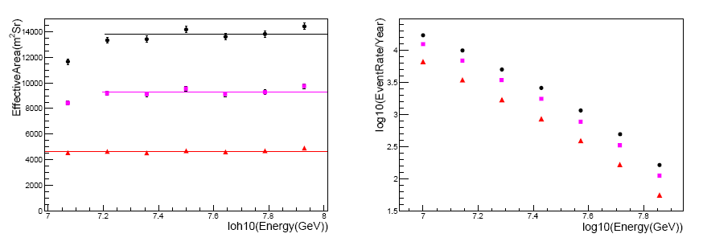
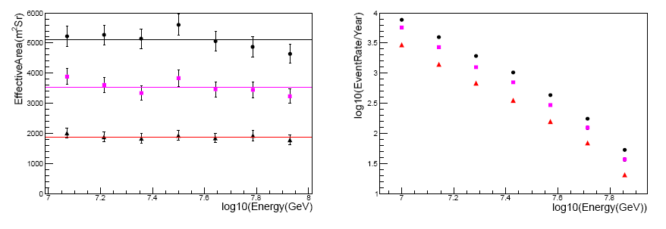
Effective aperture and event rate
15% duty cycle
50m<Rp<250m
50m<Rp<230m
50m<Rp<200m
All particle
15% duty cycle
100 irons
Iron

Slide 21
Summary
Due to the low energy threshold of LHAASO detectors, energy scales of the detectors can be obtained by crossing calibration with direct measurements
Proton or proton + helium spectra can be obtained by WCDA, KM2A, WFCTA with high statistics and high purity 90% for proton and 95% purity for proton and helium
Iron spectra can be obtained by KM2A, WFCTA with 100 gold events at 100PeV and 87% purity
With multiple detectors LHAASO can measure individual spectra of cosmic rays in a broad energy range

Slide 22
Thanks for your attention

